Slide 1
Carbon Neutral by 2030: Trinity Episcopal Cathedral Sacramento, CA [Sample] Presentation November 2023
Bob Wohlsen
Diocesan Commission on the Environment

Slide 2
Agenda
Background
Project Process
Carbon Footprint and Facility Assessment Results
Next Steps: Creating a Plan

Slide 3

Project Background: Creation Care
Church Covenant for the Care of Creation
Loving formation
Liberating advocacy
Life-giving conservation as individuals, congregations, ministries, and dioceses.

Slide 4
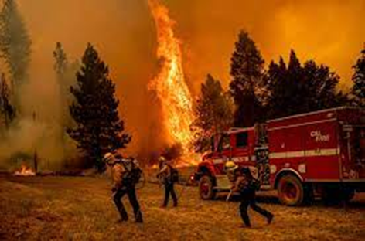
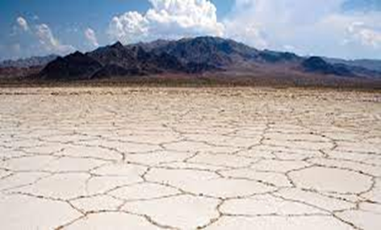

Project Background: Creation Care
Climate Action and Environmental Justice
Respect for God’s Creation
Catastrophic effects of climate change
Disproportionate effects on the poor and marginalized
Increased social disparity
Global instability

Slide 5
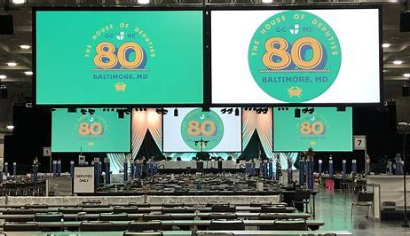
Project Background: National Church and Creation Care
General Convention Resolution A-087 (2022)
“Commit to goal of Net Carbon Neutrality in operations by 2030”
Reducing emissions from travel
Reducing energy use
Increasing energy efficiency
Purchasing offsets

Slide 6
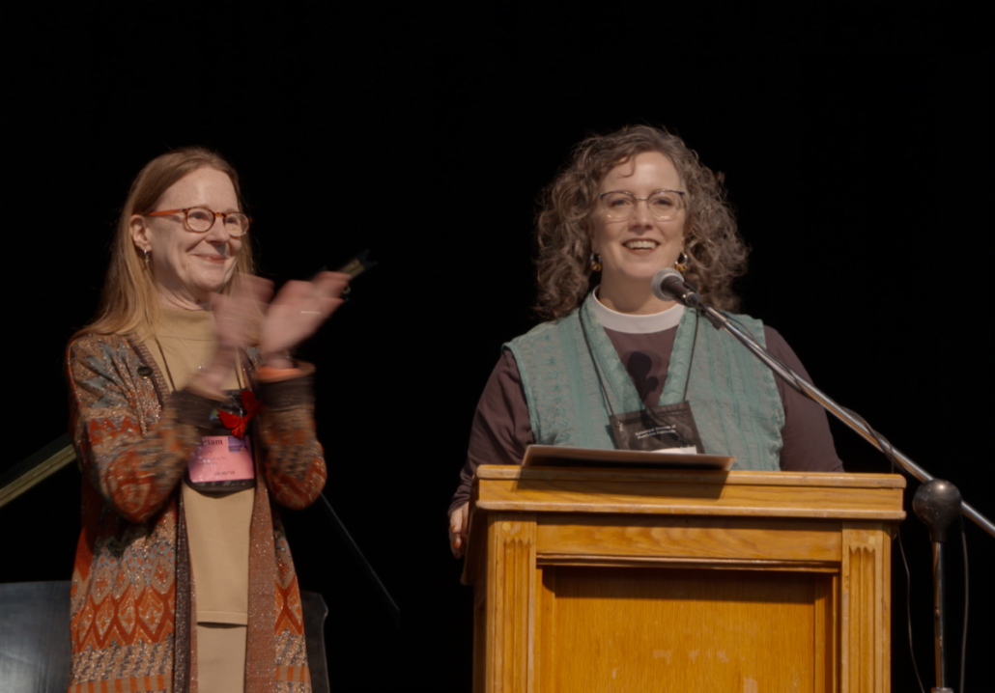
Project Background: Diocese of Northern California
General Convention Resolution A-087
“Identify Path to Carbon Neutrality by 2030”
Congregations to:
Study and pray discern how the Spirit is leading us to address climate change
Conduct a facility needs assessment
Identify actions needed to become carbon neutral
Diocesan Commission on the Environment to provide support

Slide 7

Background: What is Carbon Neutrality?
Carbon Neutrality
A balance between the carbon emitted by a facility and the amount of carbon that is absorbed or removed from the atmosphere using offsets.
A two-part equation:
Reducing carbon emissions
Providing offsets to account for the difference (plant trees, purchase carbon credits, etc.)
Energy Audit – Trinity Episcopal Cathedral

Slide 8
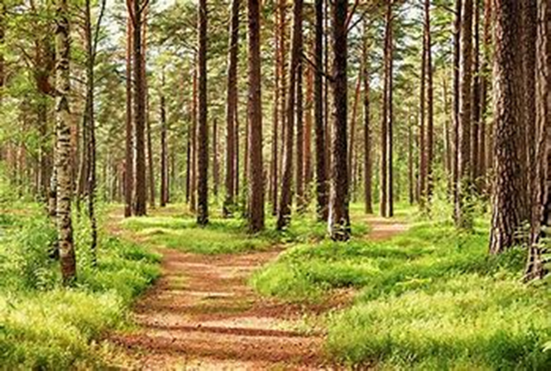
Project Background: Commission on the Environment
Commission Objectives
Provide education and guidance to congregations
Identify a path/process to assess facilities and energy use
Identify resources to help congregations further carbon neutrality by 2030

Slide 9

Trinity’s Cathedral’s Process and Progress
Four-part Process (Commission)
Form a Green Team
Measure Our Carbon Footprint
Conduct an Energy Study
Develop a Plan for Carbon Neutrality

Slide 10

Trinity’s Process and Progress
Four-part Process (Commission)
Form a Green Team
Trinity Respecting Earth and Environment (T.R.E.E)

Slide 11

Trinity’s Process and Progress
Four-part Process (Commission)
Form a Green Team
Measure Our Carbon Footprint
Interfaith Power & Light
Cool Congregations Calculator

Slide 12
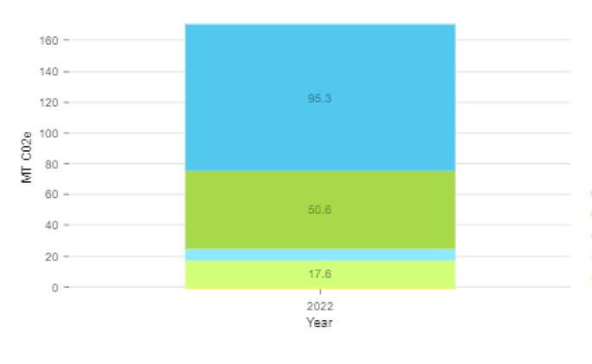
Trinity’s Process and Progress
2022 Emissions 170.6 MT CO2e metric tons CO2e
Facilities 95.3 MT CO2e
Transportation 50.6 MT CO2e Staff + Congregation
Food/Meals 07.1 MT CO2e Includes serving meat
Procurement 17.6 MT CO2e Printing, supplies, maintenance, furniture goods/services, etc.
Facility operations are the greatest emitter of CO2!

Slide 13
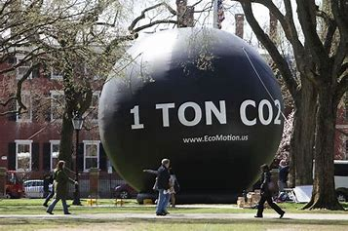
Trinity’s Process and Progress
How much is a metric ton of CO2e?

Slide 14
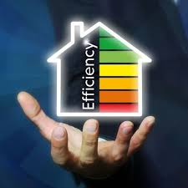
Trinity’s Process and Progress
Four-part Process (Commission)
Form a Green Team
Measure Our Carbon Footprint
Conduct an Energy Study
Energy for Purpose Audit (July 2022)
Develop a Plan for Carbon Neutrality

Slide 15
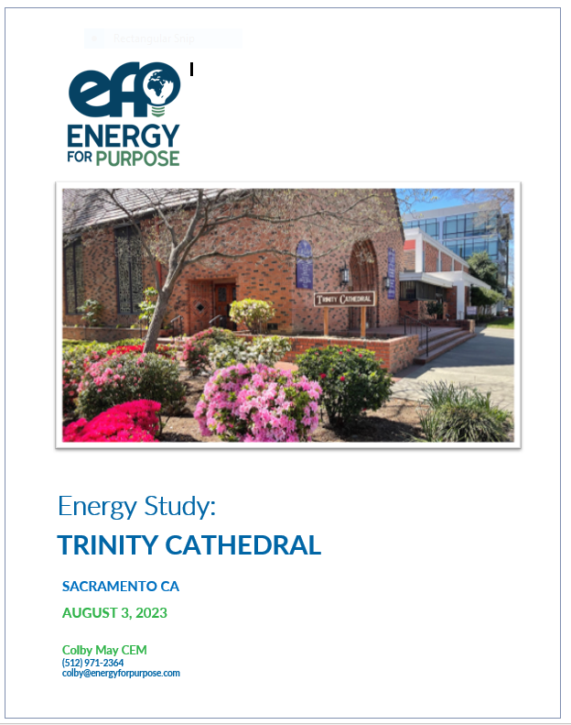
Trinity’s Energy Study and Results
Energy for Purpose Study (July 2022)
Three-part focus
Energy Efficiency
Behavior
System operations
Analyze utility use and costs
Provide findings and recommendations for reduced and more efficient energy use

Slide 16
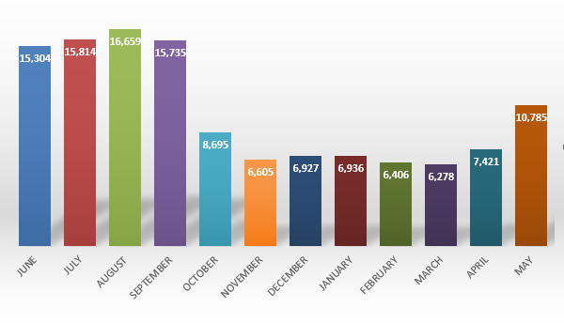
Study Results: Use of Electricity
12-Month Electricity Use (KWH): 2020-2021
32% of electricity is used for cooling

Slide 17
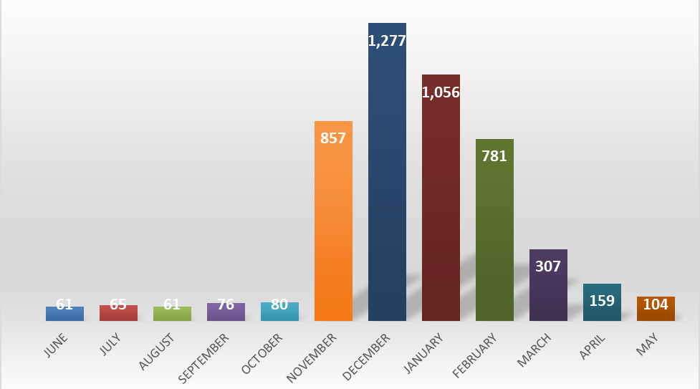
Study Results: Use of Gas
12-Month Gas Use (Therms): 2020-2021
92% of gas is used for heating

Slide 18
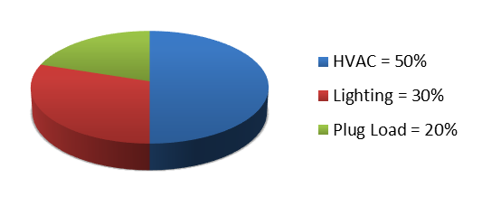
Study Recommendations
What affects energy use?
Building envelope (insulation, doors and windows, etc.)
Thermostats and controls
Occupancy
Weather conditions
Behavior
Typical Electrical Use

Slide 19
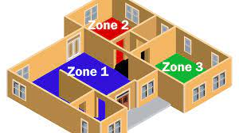
Recommended Energy Reduction and Control Measures
ERCM No.1: Sequence Operations
Adapt a “Zone Strategy”
Trinity has 9 HVAC Zones
Operate HVAC only in used zones
Modify Scheduling
Use the same zone for adjacent events/meetings
Adapt or tighten schedules to optimize HVAC use
Modify Temperatures
66-70ºF for cooling
72-76ºF for heating
Potential savings $2,767 per year

Slide 20
Recommended Energy Reduction and Control Measures
ERCM No.2: Install Wi-Fi Thermostats
Replace 15 thermostats with Wi-Fi thermostats
Enable centralized temperature control
Supports sequencing of controls
Prevents overrides
Cost
$150/250 per thermostat
PG&E can offset cost by up to $75
Potential Savings for ERMC 1 and 2
ERMC | Cost | Savings /Yr | Payback
1 | 0 | $3,000* | Instant
2 | $3,000 | $3.000* | 1 Year
* Measures 1 and 2 must occur together to achieve total savings of $3,000

Slide 21
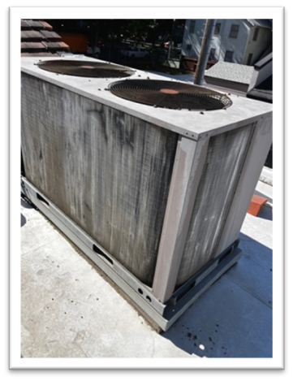
Recommended Energy Reduction and Control Measures
ERCM No.3: Replace HVAC Units
Replace 7 HVAC Units
Trinity has 15 HVAC Units
7 have outlived their useful lives
Benefits of Replacement
Increased efficiency
Enable Trinity to convert from gas to electric heat to support carbon neutrality
Estimated savings of $10,500 year in fuel expense.

Slide 22
Recommended Energy Reduction and Control Measures
ERCM No.3: Replace HVAC Units - Continued
HVAC Units Recommended for Replacement
Zone | Year Installed | Tons | Cost
AC 1 | 1989 | 3 | $9,000
AC 2 | 1989 | 3 | $9,000
AC 3 | 1989 | 7.5 | $22,5000
AC 4 | 1989 | 10 | $30,000
AC 5 | 1989 | 5 | $15,000
AC 6 | 1989 | 4 | $12,000
AC 9 | 1989 | 15 | $45,000
AC 12 | 1989 | 5 | $15,000
TOTAL |  | 37.5 | $157,500
An annual cost–savings of $10,500 enables payback in 11 years.

Slide 23


Recommended Energy Reduction and Control Measures
ERCM No.4: Replace Lighting with LEDs
Inefficient Lighting/Lamp Types Throughout Campus
Many lights and lamps no longer manufactured
Utility companies recommend replacing models to enhance efficiency.
Replace with 2-lamp 13 or 15 walt LED linear fluorescents
Benefits of Replacement
Decreased energy consumption (up to 80% less energy)
Increased lifetime (5X longer life)

Slide 24
Recommended Energy Reduction and Control Measures
ERCM No.4: Replace Lighting with LEDs - Continued
Existing and Proposed Lighting
No. of Fixtures | Existing Lamp | Replacement Lamp | Cost
3 | 60-watt Inc | 8-watt LED equivalent | $30
106 | 32-watt T8 | 13-watt LED equivalent | $5,300
4 | 40-watt T12 | 13-watt LED equivalent | $80
TOTAL |  |  |  | $5,410

Slide 25
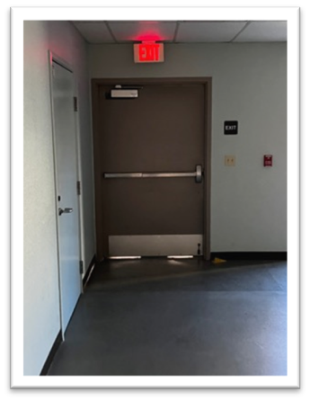
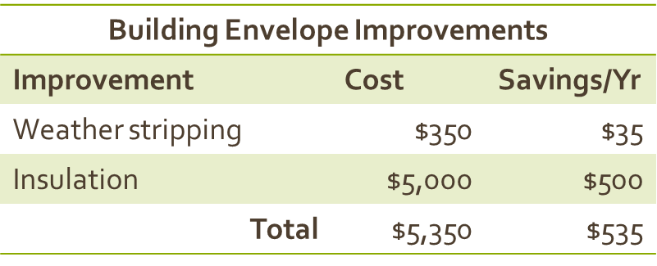
Recommended Energy Reduction and Control Measures
ERCM No.5: Building Envelope
Proposed Maintenance, Retrofits, Improvements
Doors: Upgrade weather stripping ($350)
Insulation: 50% ceilings on top floor lack insulation

Slide 26

Recommended Energy Reduction and Control Measures
ERCM No.6: Low-Cost Opportunities
Lights Turn off lights/install censors/modify behavior
Water From 1400 to 1200
Plug Load Install 5 adaptors ($20/each)
Commodes When replaced, install low-flow units
Awareness Provide ongoing education to staff and facility users.

Slide 27
Trinity Study - Summary
Summary of Energy Cost Reduction Measures for Trinity Cathedral
Measure | Project |  | Cost ($) | Savings ($) | Payback (Years)
1 & 2 | Change sequence of operations (controls) |  | $3,000 | $3,000 | 1
3 | Replace older HVAC Units |  | $157,500 | $10,500 | 15
4 | Replace older lamps with LEDs |  | $5,410 | $1,082 | 5
5 | Weather strip doors, windows and insulation in 2nd Flr. |  | $5,350 | $535 | 10
6 | Pursue reduce water temperatures, turn of lights, install plug load adaptors, etc. |  | $0 | $250 | <1
TOTAL |  |  | $171,260 | $15,367 | 15

Slide 28

What’s Next?
Four-part Process (Commission)
Form a Green Team
Measure our Carbon Footprint
Conduct an Energy Study
Develop a Plan for Carbon Neutrality

Slide 29

Thought, Prayer, and Planning!
Step 1: Review What We Know
IPL Carbon Emission Categories
Facility Operations
Transportation
Food
Procurement
EfP Facility Recommendations
Other Considerations
Planned facility improvements
Behavior changes since COVID-19
(e.g., Zoom v. in-person, gathering and meals, etc.)

Slide 30
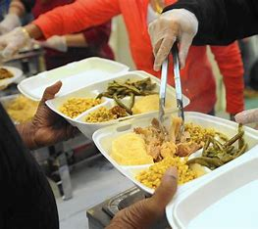
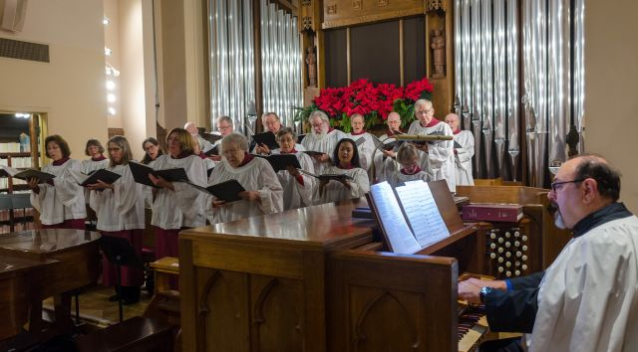
Thought, Prayer, and Planning!
Step 2: Consider Mission, Goals, and Values
Identify church missions and ministries, for example:
Liturgy and Worship
Community Outreach
Spiritual Formation and Education
Would any of the reports/recommendations or creation care goals affect your mission and ministry?
In-person gathering v. zoom meeting
Paper v. electronic communication
Community meals and outreach and dietary choices.

Slide 31

Thought, Prayer, and Planning!
Step 2: Consider Mission, Goals, and Values
If conflicts arise, consider….
Can we adapt ministries/practices to further Creation Care goals (e.g., schedules and formats)?
Provide carbon offsets for targeted missions and ministries?

Slide 32
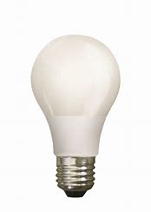
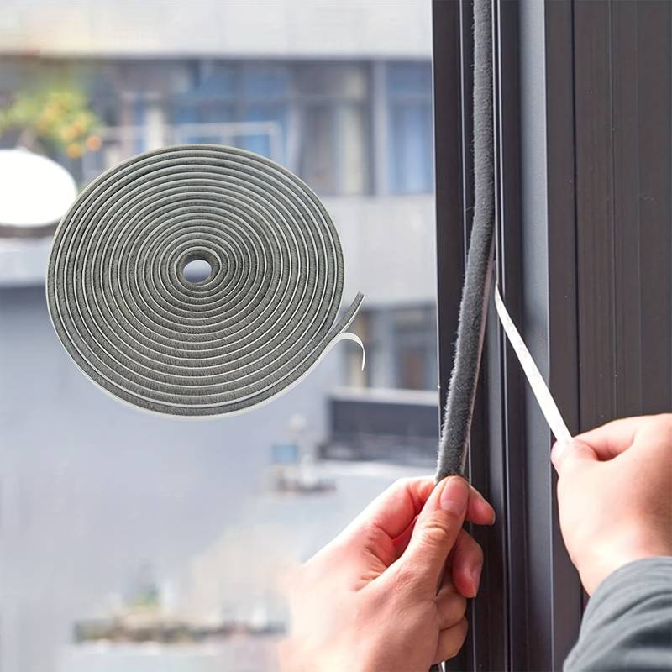

Thought, Prayer, and Planning!
Step 3: Identify Creation Care Goals and Priorities
Identify specific goals and timeframes
Short-range goals (Present to 1 year: 2023-24)
Mid-range goals (Years 2 to 4: 2025-28)
Long-range goals (>5 years: 2029 and beyond)
Create a budget for each goal
Consider available funding resources (grants)

Slide 33

Thought, Prayer, and Planning!
Step 4: Allocate Resources and Budgets
Work closely with vestry and staff
Incorporate creation care measures into annual budget and facilities planning
Step 5: Document and Share Progress!
Document creation care meetings and decisions
Document vendor conversations
Track progress—including challenges and delays!

Slide 34
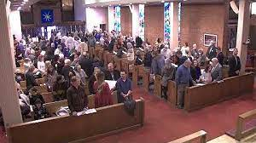
Thought, Prayer, and Planning!
Step 5: Document and Share Progress – continued
Provide regular opportunities for prayer and sharing
Make creation care an agenda item across ministries
Reach out to other congregations to compare notes

Slide 35
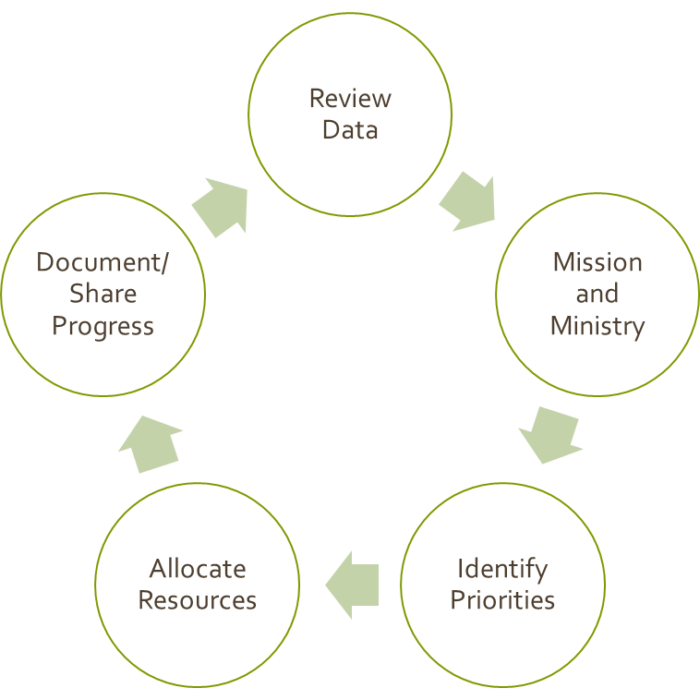
Tools From the Commission
Planning Tools
Templates for data sharing and planning
Finance/funding resources
Educational resources on climate care and carbon neutrality
A network of dedicated partners to call!

Slide 36

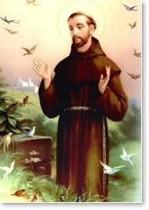

And Remember…
We’re in this together!

